Slide 1

MONGODB INDEXES
NAME : VARADHA . N
UID : 161101
MAIL ID : varadha.nair@ust.com
DATE : 10/12/2020

Slide 2
INITIAL OPERATIONS

Slide 3
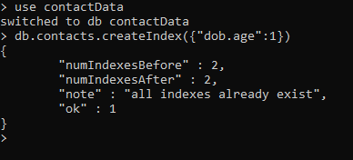
CREATE INDEX
> use contactData
switched to db contactData
> db.contacts.createIndex({"dob.age":1})
{
"numIndexesBefore" : 2,
"numIndexesAfter" : 2,
"note" : "all indexes already exist",
"ok" : 1
}
>

Slide 4
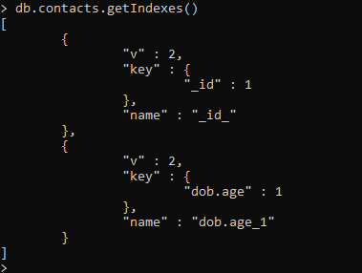
GET INDEX
> db.contacts.getIndexes()
[
{
"v" : 2,
"key" : {
"_id" : 1
},
"name" : "_id_"
},
{
"v" : 2,
"key" : {
"dob.age" : 1
},
"name" : "dob.age_1"
}
]
>

Slide 5

DROP INDEX
> db.contacts.dropIndex({"dob.age":1})
{ "nIndexesWas" : 2, "ok" : 1 }
>

Slide 6
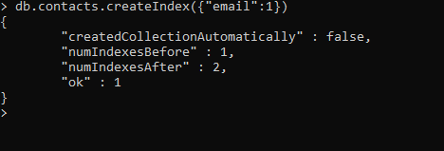
SINGLE INDEX
> db.contacts.createIndex({"email":1})
{
"createdCollectionAutomatically" : false,
"numIndexesBefore" : 1,
"numIndexesAfter" : 2,
"ok" : 1
}
>

Slide 7
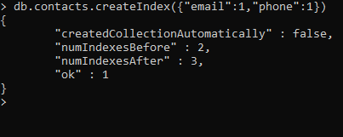
COMPUND INDEX
> db.contacts.createIndex({"email":1,"phone":1})
{
"createdCollectionAutomatically" : false,
"numIndexesBefore" : 2,
"numIndexesAfter" : 3,
"ok" : 1
}
>

Slide 8
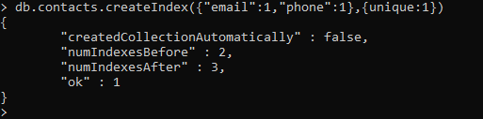
UNIQUE INDEX
Index created by unique fields or fields should have only unique value
> db.contacts.createIndex({"email":1,"phone":1},{unique:1})
{
"createdCollectionAutomatically" : false,
"numIndexesBefore" : 2,
"numIndexesAfter" : 3,
"ok" : 1
}
>

Slide 9
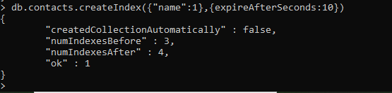
TTL INDEX
The data indexed based on this index will be expired after specified time in seconds.
> db.contacts.createIndex({"name":1},{expireAfterSeconds:10})
{
"createdCollectionAutomatically" : false,
"numIndexesBefore" : 3,
"numIndexesAfter" : 4,
"ok" : 1
}
>

Slide 10
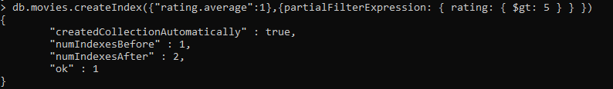
PARTIAL FILTER INDEX
It is created or used based on specific rules.
> db.movies.createIndex({"rating.average":1},{partialFilterExpression: { rating: { $gt: 5 } } })
{
"createdCollectionAutomatically" : true,
"numIndexesBefore" : 1,
"numIndexesAfter" : 2,
"ok" : 1
}

